Slide 1
Edinburgh Business School MBA
AUC Academic Partner
Strategic Planning
Module 6 - Part 1
Internal Analysis of the Company
Instructor: Moataz Darwish, MBA

Slide 2
Contents
6.1 Opportunity Cost 6/3
6.2 Fixed Costs, Variable Costs and Sunk Costs 6/4
6.3 Marginal Analysis 6/5
6.4 Diminishing Marginal Product 6/8
6.5 Profit Maximisation 6/10
6.6 Estimating Production Costs 6/10
6.7 Accounting Techniques: Break Even, Payback and Sensitivity 6/13
6.8 Accounting Ratios 6/17
6.9 Benchmarking 6/22
6.10 Research and Development 6/23
6.11 Human Resource Management 6/29
6.12 The Scope of the Company 6/31
6.13 The Value Chain 6/40
6.14 Competence 6/43
6.15 Strategic Architecture 6/49
6.16 Strategic Advantage Profile 6/54
EBS MBA / AUC

Slide 3
The Scope of the Company
Economies of scale
Economies of scope
Diversification
Synergy
Vertical Integration
Fixed Costs, Variable Costs and Sunk Costs
Estimating Production Costs
Accounting Ratios
Opportunity Cost
Marginal Analysis
Diminishing Marginal Product
Profit Maximization
Module 6
Value Chain
Competence
Strategic Architecture
Accounting Techniques: Sensitivity Analysis
Break-Even Analysis
Payback Period
Research and Development:
Research and Innovation
Development
Human Resource Management
Types of cultures
Benchmarking
EBS MBA / AUC

Slide 4
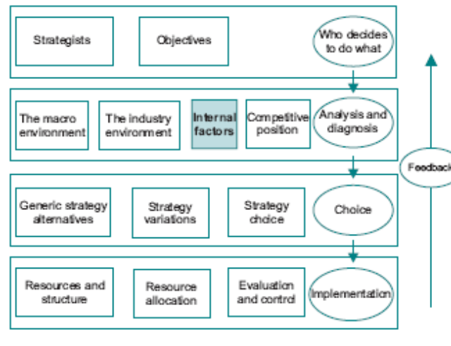
The Model
EBS MBA / AUC

Slide 5
Introduction
Using analytical tools from different disciplines to:
  to assess the effectiveness with which resources have been allocated in the past,
  identify the sources of competitive advantage
  estimate the strengths and weaknesses of the company
EBS MBA / AUC

Slide 6
Opportunity Cost
Constraints on the resources requires choice amongst alternatives.
The best alternative forgone is the opportunity cost of the action chosen.
EX.
The opportunity cost, in purely financial terms, of spending $1 million on marketing is to reduce prices because this is the next best alternative; since these two options have a similar level of risk they can be compared directly.
Help identify relevant tradeoffs and establish priorities.
The idea can be used to evaluate resource allocation options at all levels in the company;
From the strategy viewpoint it helps to focus on the following questions:
  ‘Have we identified all relevant options?’
  and ‘How do the options compare with each other?’
EBS MBA / AUC

Slide 7
Fixed Costs, Variable Costs and Sunk Costs
Many accounting systems ignore the fact that some costs are fixed and some are variable with respect to changes in output.
Many accountants are firmly convinced that each product must bear its share of overheads. Application of this principle can lead to misallocation of resources.
Factory rent is an example of a fixed cost; no point to reallocating factory rent over the new range of output and changing the calculation of unit cost.
Materials are a variable input, hence the cost of materials must be taken into account in deciding the level of output.
Sunk costs are the costs which were incurred in the past, and as a result cannot vary with respect to output.
Expenditure on development incurred last quarter is a sunk cost, and therefore has no bearing on whether to continue developing a product.
EBS MBA / AUC

Slide 8
Fixed Costs, Variable Costs and Sunk Costs
When making strategy decisions it is obviously important to make sure that the appropriate costs are taken into account;
Sunk costs are a particularly important strategic consideration for barriers to entry; if the costs of entry are recoverable then they are not sunk as far as the strategic move is concerned.
The fact that a cost was incurred in the past does not necessarily make it sunk.
EBS MBA / AUC

Slide 9
Marginal Analysis
Marginal cost principle:
Being the change in costs as output varies
Outcome of failing to distinguish between fixed and variable cost is focusing on average costs - major error.
Marginal cost - only relevant costs should be taken into account in making pricing and output decisions.
  excludes fixed cost – hence significantly lower than average cost.
  used as a guide to the minimum acceptable price.
The benefit of thinking in marginal terms is that it focuses on the costs and benefits associated with specific actions.
The additional amount gained from the sale of each additional unit is known as marginal revenue
Marginal cost pricing – one off prices (ex. Hotel night)
EBS MBA / AUC

Slide 10
Diminishing Marginal Product
Marginal cost vary because productivity of resources varies at the margin.
  Ex. Hectare of land
This has important implications for:
  determining the scale of company operations, ex hiring additional workers.
  allocation of resources among company activities (optimum allocation), ex. government employees.
  at the corporate level, where SBUs are competing for scarce funds - allocate resources based on it.
EBS MBA / AUC

Slide 11
Profit Maximisation
Profit maximising output is that where marginal cost equals price.
The two questions that are really about profit maximisation:
  ‘What are the additional expected costs?’ and
  ‘What are the additional expected revenues?’
Notion of profit maximisation is concerned with efficient resource allocation given the tastes and preferences of consumers;
The great economist Adam Smith pointed out that everyone can be made better off through the pursuit of profit maximisation, since this leads to the most efficient use of resources in an economy.
EBS MBA / AUC

Slide 12
Estimating Production costs
Disagreement between economists and accountants.
Many accounting systems are simply incapable of providing an answer to the question of how much it costs to produce a particular product, and how costs vary as the level of output changes.
The debate has centered on the concept of marginal (economists) versus average (accountants) costs, and on expected future costs versus historical costs.
Economists argue that sunk costs should be excluded from decision making information, and that the only use for historical costs is to provide guidance on what costs are likely to be in the future;
The general principle to apply is that if the company accounting system does not provide information which is consistent with economic concepts there is a good chance that mistaken decisions will be made.
EBS MBA / AUC

Slide 13
Joint Production
The classic case of joint production is that of a sheep, which produces both wool and mutton;
The key problem is cost allocation - An example is activity based costing, if the resources devoted to a particular output cannot be identified, neither can the costs.
the manager should be aware that allocated costs may be irrelevant for decision making purposes.
it may not be possible to identify variable costs separately.
Strategic Implications:
  it may not be possible to produce certain products on their own
  And/or compete effectively with those produced under conditions of joint production.
EBS MBA / AUC

Slide 14
Accounting Techniques: Break Even, Payback and Sensitivity
EBS MBA / AUC

Slide 15

Break-Even Analysis
Breakeven Analysis: ‘How many units would have to be sold before the product starts making a net contribution?’
A simple version:
  Cost side:
Total cost = Sales × Variable unit cost + Fixed cost
  Revenue side:
  Total Revenue = Sales × Price
  Solve for sales:
Is total sales requirement attainable before the product makes a positive cash contribution? based on the marketing information.
Sensitivity analysis can be used to identify conditions under which the product will not even cover its production costs.
Breakeven analysis is obviously limited in that it concentrates only on the volume of output and sales, and does not take into account the passage of time;
EBS MBA / AUC

Slide 16
Payback Period
‘How long will it be before the project pays back its start up costs?’
The payback period is the length of time until the running total becomes positive.
There is some dispute as to whether the payback period adds to the information produced by a properly executed net present value analysis.
What is important is to generate information on different aspects of investments so that corporate decision makers can arrive at a well balanced view of the implications of different courses of action.
EBS MBA / AUC

Slide 17
Sensitivity Analyses
When making predictions about the future it is not possible to be precise, but it is possible to have some idea of the range of values likely to be associated with important variables.
At the very least, the best possible and worst possible scenario for each important variable can be projected.
Sensitivity analysis is related to the investigation of scenarios, but is conducted at a more detailed level.
Sensitivity analysis can be carried out in relation to different dimensions of performance.
powerful technique for generating a perspective on the potential returns from a course of action.
It identifies which are the crucial variables, and where unexpected threats may exist.
A somewhat less obvious aspect of sensitivity analysis is to identify the combination of circumstances which are necessary to ensure success.
EBS MBA / AUC

Slide 18
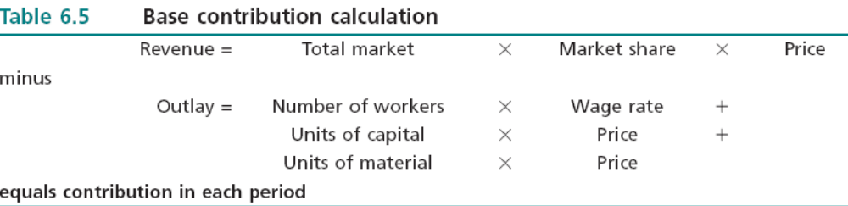
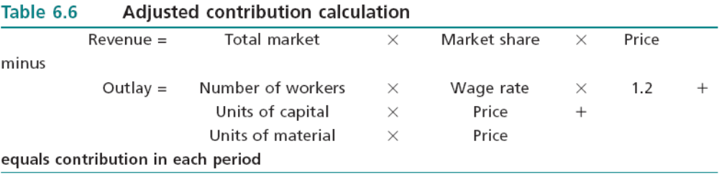
Sensitivity Analyses
EBS MBA / AUC

Slide 19
Accounting Ratios
Accounting
Finance
  efficiency with which resource allocation to-date
  resource allocation in the future
Ratios:
  provide information on different dimensions of company performance.
  assess the effectiveness with which resources have been allocated in the past.
  can identify potential weaknesses in company management.
  no definitive set of ratios.
EBS MBA / AUC

Slide 20
Accounting Ratios
Ratios produce performance measures which relate to the efficiency with which resources are allocated, appropriate measures must be used for:
  Revenues / Costs / Assets
  Assets appear in the bottom line of most of the measures,
The following ratios are typically encountered in company accounts:
  ROI Return on Investment
  RONA Return on Net Assets
  ROCE Return on Capital Employed
  ROTA Return on Total Assets
  Value Added
  Earnings per Share
  Gearing ratio
EBS MBA / AUC

Slide 21
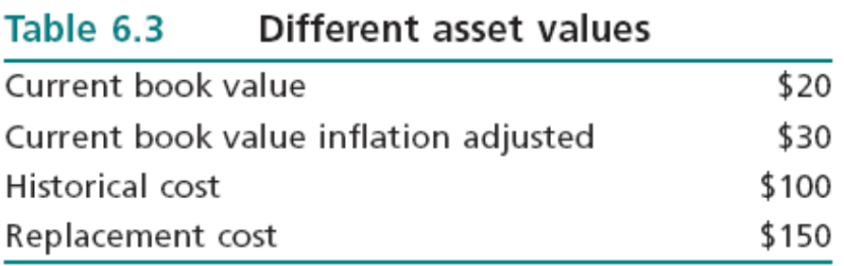
Accounting Ratios
  Value of assets is an issue.
  Revenues and costs must not include changes in the portfolio of assets; which is not directly related to the efficiency with which inputs are being converted to outputs - disguise a particularly good or bad year.
  A further issue is the problem of lease or buy with respect to the acquisition of assets, choice can have a significant impact on the ratio.
EBS MBA / AUC

Slide 22
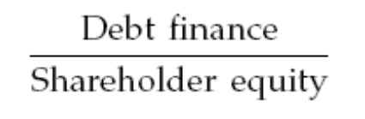
Accounting Ratios
  Companies have three sources of finance: retained profits, equity issues and loans.
  The main difference between debt finance and equity finance is that the interest on debt takes priority over payments of dividends to shareholders.
  A measure of the risk associated with debt financing is the gearing ratio, defined as:
  Number of factors determines what is the optimal gearing ratio:
    sound track record
    The higher the gearing ratio, say around 100%, the more reliant it is on steady and non fluctuating profits over time.
    The company needs to balance off dividend payments against the loss of flexibility which may result from a high gearing ratio.
    There is therefore no optimal gearing ratio which applies to all companies, or even to a given company over a period.
EBS MBA / AUC

Slide 23
Benchmarking
A company’s competitive position can only really be assessed in relation to other companies in the industry.
The performance of major competitors can be ascertained from the information in their annual reports.
It is necessary to ensure that like is compared with like.
There is no guarantee that competitors are pursuing best practice.
The type of question which needs to be addressed includes:
  Why are competitors’ return on capital greater or less than ours, and what does this tell us about our own use of resources?
  How does competitors’ financial strength (in terms of gearing, cash reserves etc.) compare with ours, and what flexibility does this give them?
EBS MBA / AUC

Slide 24
Benchmarking
At least two reasons why benchmarking must be treated with caution:
  impossible to compare like with like due to different portfolios, products, synergies, stages in life cycle…etc
  It is how performance is achieved, rather than the fact that it is being achieved, which is needs to be identified, but this is very difficult to achieve.
  The UK retailer Marks and Spencer served as a benchmark for other retailers for many years; but when it lost its competitive advantage it was actually quite difficult to pinpoint exactly what had gone wrong.
EBS MBA / AUC

Slide 25
Research and Innovation
If we don’t change our direction, we’re likely to end up where we’re headed.
Chinese proverb
EBS MBA / AUC

Slide 26
Research and Innovation
Innovation in
  Technologies
  Way we use them
  Way we work together
EBS MBA / AUC

Slide 27
Research and Innovation
Schumpeter:
‘Creative Destruction’,whereby periods of comparative quiet are punctuated by shocks when old sources of competitive advantage are destroyed and replaced by new ones.
He argued that the entrepreneurs who exploit the opportunities created by the shocks go on to achieve positive profits during the next period of calm.
EBS MBA / AUC

Slide 28
Research and Innovation
Thus dynamic resource allocation is more important than static efficiency.
Thus one of the requirements for achieving competitive advantage is to adopt an innovative stance
  recognize new ideas and changes
  be ready to implement them when they occur.
Due to technological progress and information technology the sources of competitive advantage are being eroded at an increasing rate.
  seek to achieve a sequence of temporary advantages that keep it ahead of the rest of the industry.
EBS MBA / AUC

Slide 29
Research and Innovation
Two stages to the problem of allocating resources to research:
  How much to spend on research???
  What criteria to use in order to identify potentially profitable products from the possibilities produced by research GIVEN insufficient resources to exploit all potential products???
    first come basis?
    constant percentage of total costs, or total sales.
    potential returns from research expenditure
    opportunity cost of research expenditure (tradeoffs)
    a complicating factor: joint production involved in research (pure research) and development output.
    spillover effect:the higher is research expenditure, the lower the development expenditure required to attain a given development objective.
EBS MBA / AUC

Slide 30
Research and Innovation
Bringing these various factors together, the quest for efficiency in research expenditure can be assisted by identifying the most important indicative factors and assessing their relative importance:
Research Expenditure: Indicative Factors
  Measurement of research expenditure
  Past research budget: constant or variable
  Expenditure as proportion of sales, total cost
  Track record of new ideas
  Spillover effects (with development)
  Power base (of research personnel)
EBS MBA / AUC

Slide 31
Development
Product development starts when: the product is selected for development from the prototype stage and often continues after launch and throughout the product life.
In order to maintain market share, companies continually upgrade their products in line with new technologies and customer expectations.
After creation of a prototype, various questions needs to be tackled:
  how much should be spent on developing the product?
  when it should be launched?
  what price should be charged?
  what marketing effort should be devoted to it?
  … and so on.
EBS MBA / AUC

Slide 32
Development
The development of a product sets the stage for a series of conflicts among groups whose objectives differ:
  Development Engineer – producing a ‘good’ product involving soud characteristics of construction and operation
  Financial Controller - keep costs within budget limits,
  Marketing Manager - get the product to customers quickly, gain first mover advantage
  Corporate Manager - gain first mover advantage
EBS MBA / AUC

Slide 33
Development
‘How much should be spent on developing it?’
  The first step is to apply the microeconomic concept of marginal analysis, and concentrate attention on marginal cost and marginal benefit.
    The decision to increase development expenditure by one dollar must be based on the implicit assumption that the marginal benefit is at least one dollar.
    expected marginal benefit might be estimated by assuming launch date, expected market share, unit cost and selling price.
    risk and uncertainty must be faced by using sensitivity analysis to identify the impact of different assumptions.
EBS MBA / AUC

Slide 34
Development
Research, innovation and development can be brought together into a single model.
This whole process can be termed ‘innovation’ because each stage requires new thinking.
When viewed as a process two distinct management problems become apparent:
  each stage must be managed effectively
  the link between stages must be efficient
EBS MBA / AUC

Slide 35
Development
Innovation as a process
Invention
what incentives exist? Intellectual property rights and principal agent issues.
Many possibilities for delay.
Need for monitoring the process.
organization needs to pay a great deal of attention to incentives and be adaptable to changing priorities at different stages.
screening mechanism
Prototype
criteria to determine what has the potential
Patenting Delay, is it needed?
Patent
invention cannot be defined well enough for patenting purposes, imitation threat
Prioritizing prototypes
Development
how much should be spent?
Conflict between engineers and marketers
Launch
proper positioning in terms of differentiation and price.
Success of launch?, further resources?
abandonment?
Market exploitation
marketing approach
EBS MBA / AUC

